Slide 1
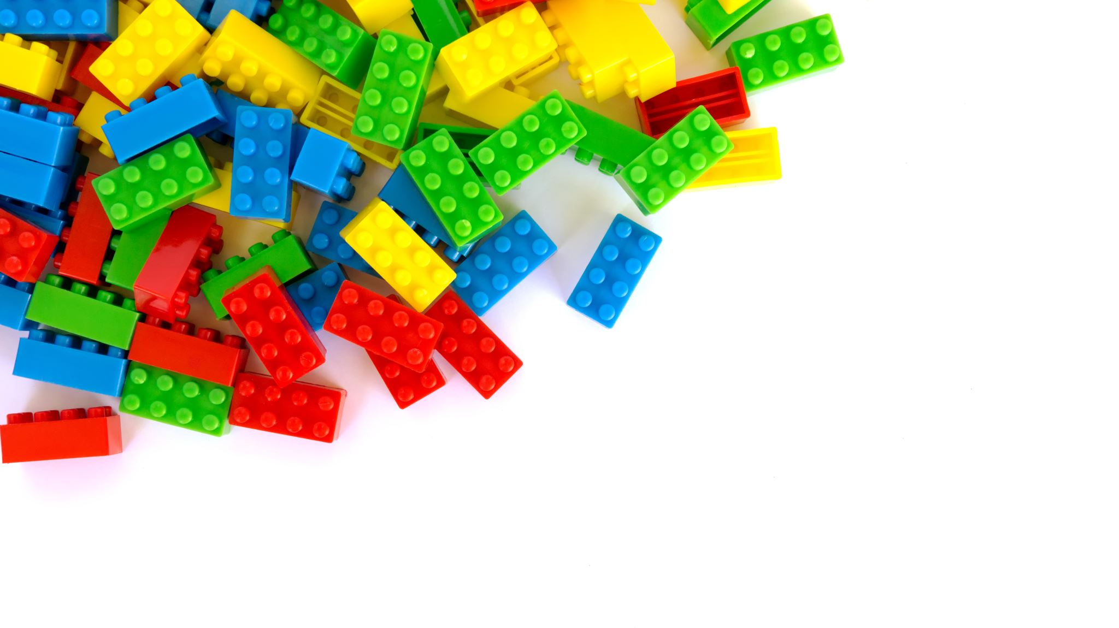
Tensors Explained with Lego Blocks From Dots to Cube – Lets Build our way to Understanding
Saima Sano
ITAI-2376
Anna Devarakonda
Date: June 28th, 2025

Slide 2
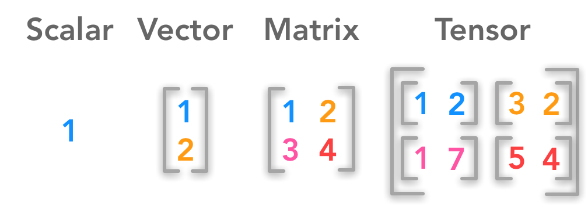
Tensors
In machine learning and deep learning, a tensor is the basic data structure used to represent data. Think of tensors as multi-dimensional arrays or grids of numbers.
They hold input data (like images, text, or audio), model parameters (weights), and intermediate computations inside neural networks.
For example:
A scalar tensor can represent a single number (like a loss value).
A vector tensor might represent a list of features or word embeddings.
A matrix tensor could represent a batch of inputs or weights.
Higher-dimensional tensors are used for things like batches of images (with width, height, channels, and batch size dimensions).
Libraries like TensorFlow and PyTorch are named after tensors because they heavily use these structures to perform mathematical operations efficiently on CPUs and GPUs.
So, in AI, tensors are the building blocks for feeding data into models, performing calculations, and learning patterns.

Slide 3
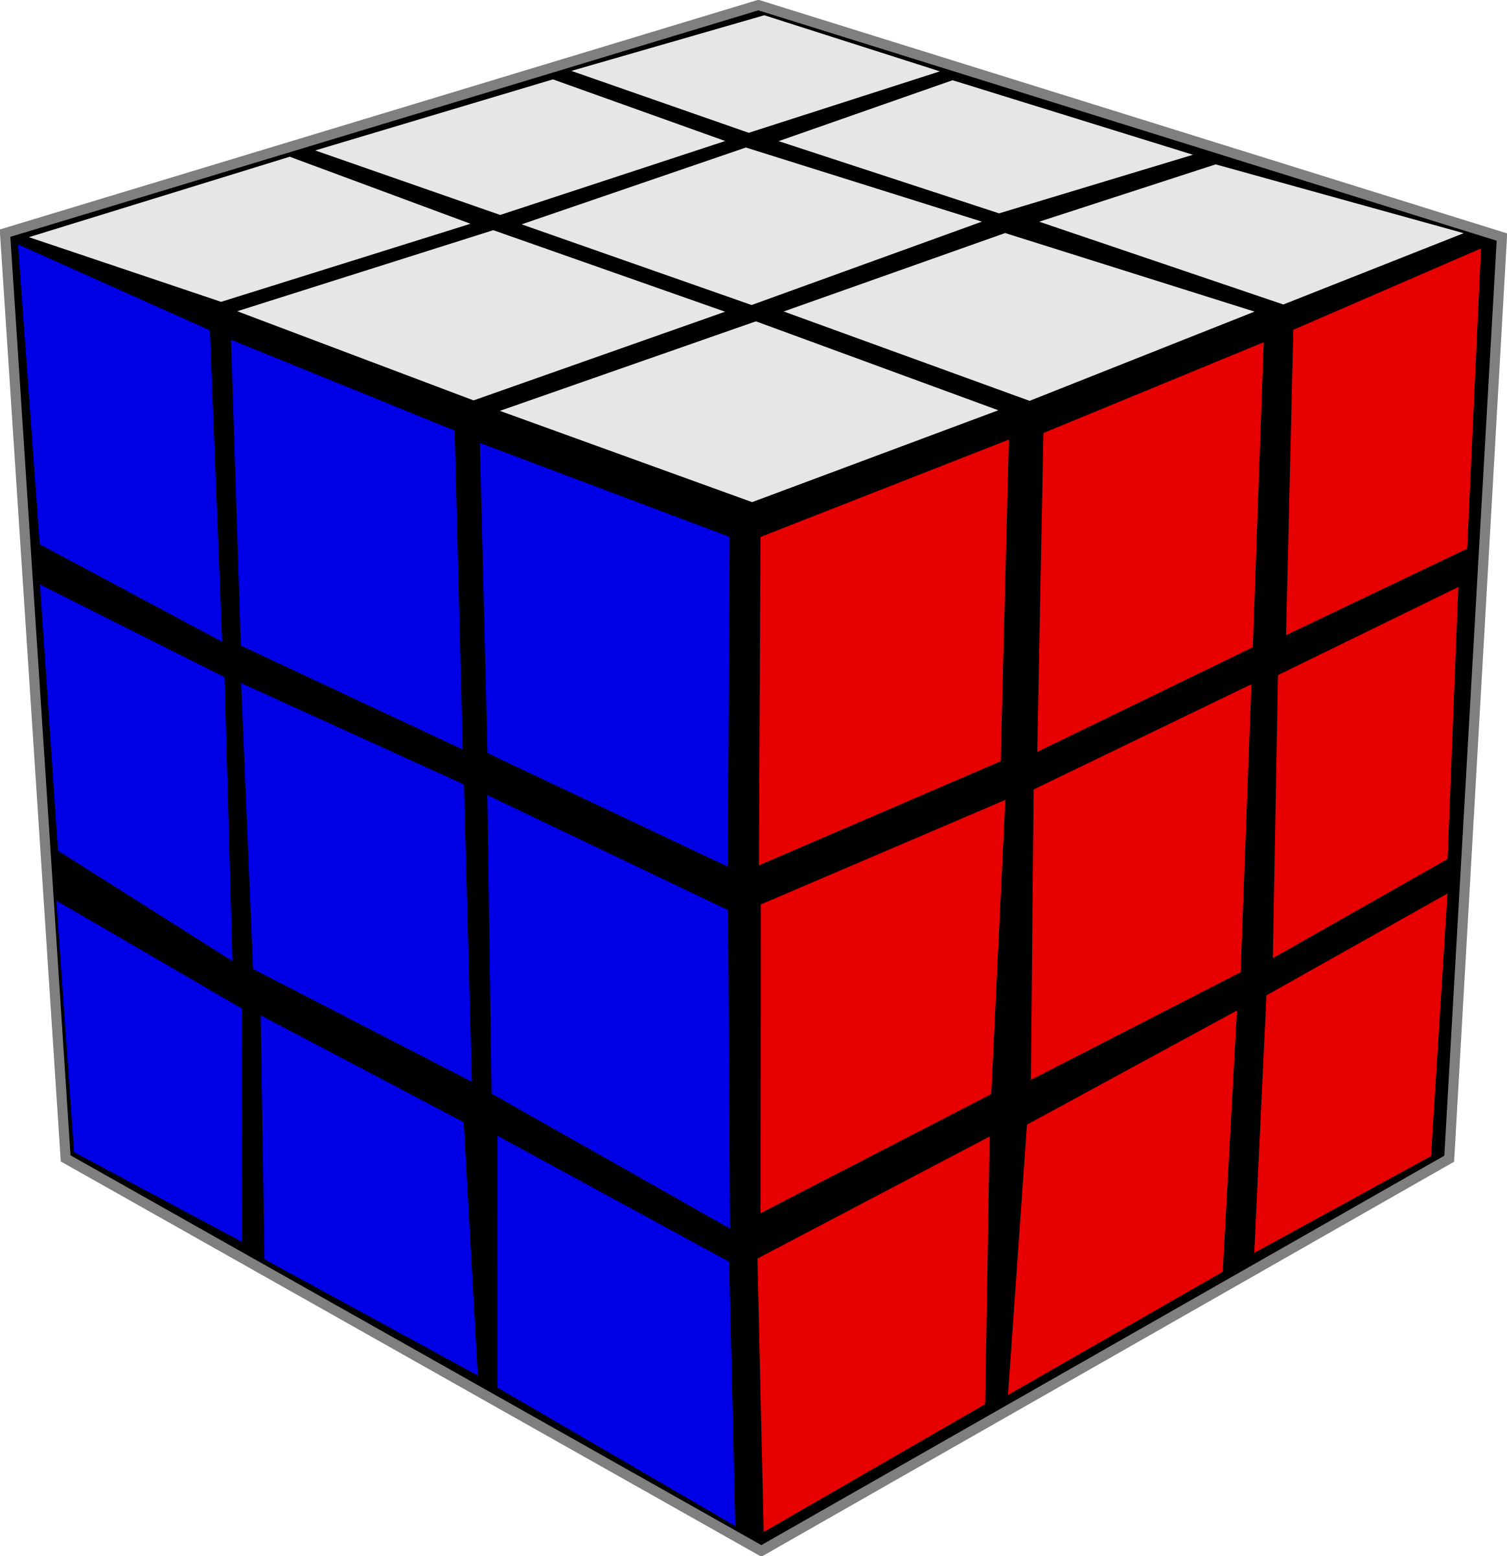
Meet the Tensor Family Title
I am One
Scalar =
Vector =
Matrix =
Tensor =
I am a straight line
I am a table
I am 3D-like a LEGO piece

Slide 4
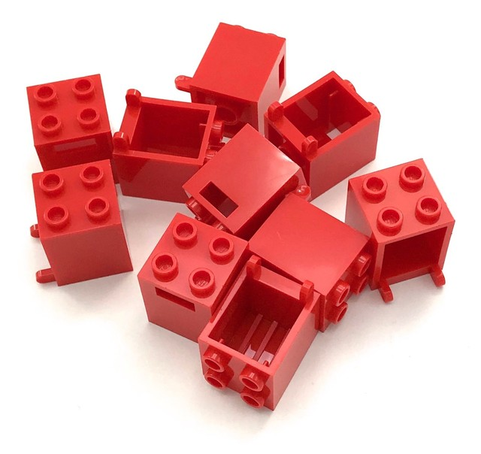
Scalar
A Single number or a single piece of information
On the right, you see how many red blocks.
We have 9 blocks
That “9” is our first type of tensor! It’s just one number, one piece of information. Scientists call this a “scalar:. It is like a LEGO brick with just one stud – its there, but it doesn’t point anywhere special

Slide 5
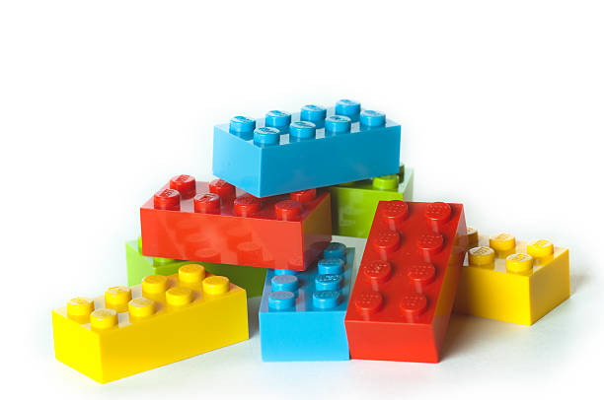
Vector
A list of numbers, where each number represents something specific, and they have a direction or order.
On the right, Let's make a list of how many of each color we have.“ How many red? How many blue? How many yellow?“
[2 blue, 2 green, 2 red, 2 yellow]
"This list is our next type of tensor! It's called a 'vector.' It's like a row of LEGO bricks, where each brick tells us something different, and they are lined up in a specific order. It tells us not just what we have, but how many of each, like a direction for our information!"

Slide 6
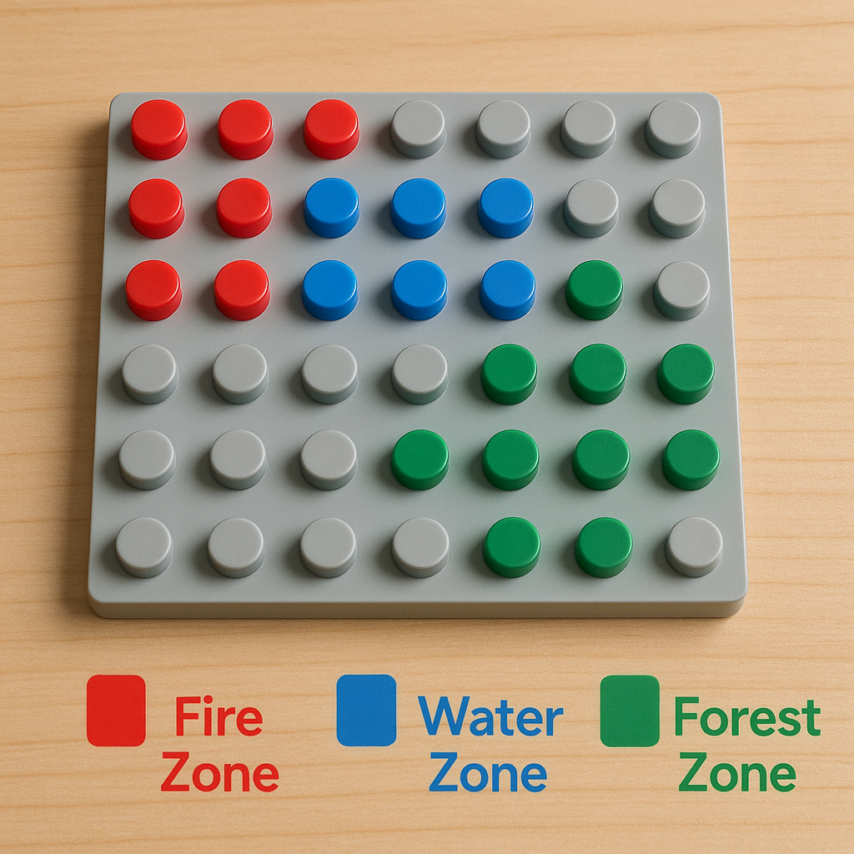
Matrix
A table of numbers (rows and columns) that describes relationships between different things. This is where it gets interesting for LEGOs!
We're going to map out our LEGO world.
Red studs mean 'Fire Zone’
Blue studs mean 'Water Zone’
Green studs mean 'Forest Zone’
There are 2 ways to explain the base plate on right,
It has red, blue and green blocks
Or
(R1, C1) (R1, C2) (R1, C3) red
(R2, C1) (R2, C2) red
(R3, C1) (R3, C2) RED, so on and so forth
That's exactly what a Level 2 tensor, or a 'matrix,' does! It's like a grid or a table of information. We need two pieces of information (Row and Column) to find out what's in each spot. This entire baseplate, with all its colored studs, is like a Level 2 tensor. To know what's here [point], we need its row AND its column.

Slide 7
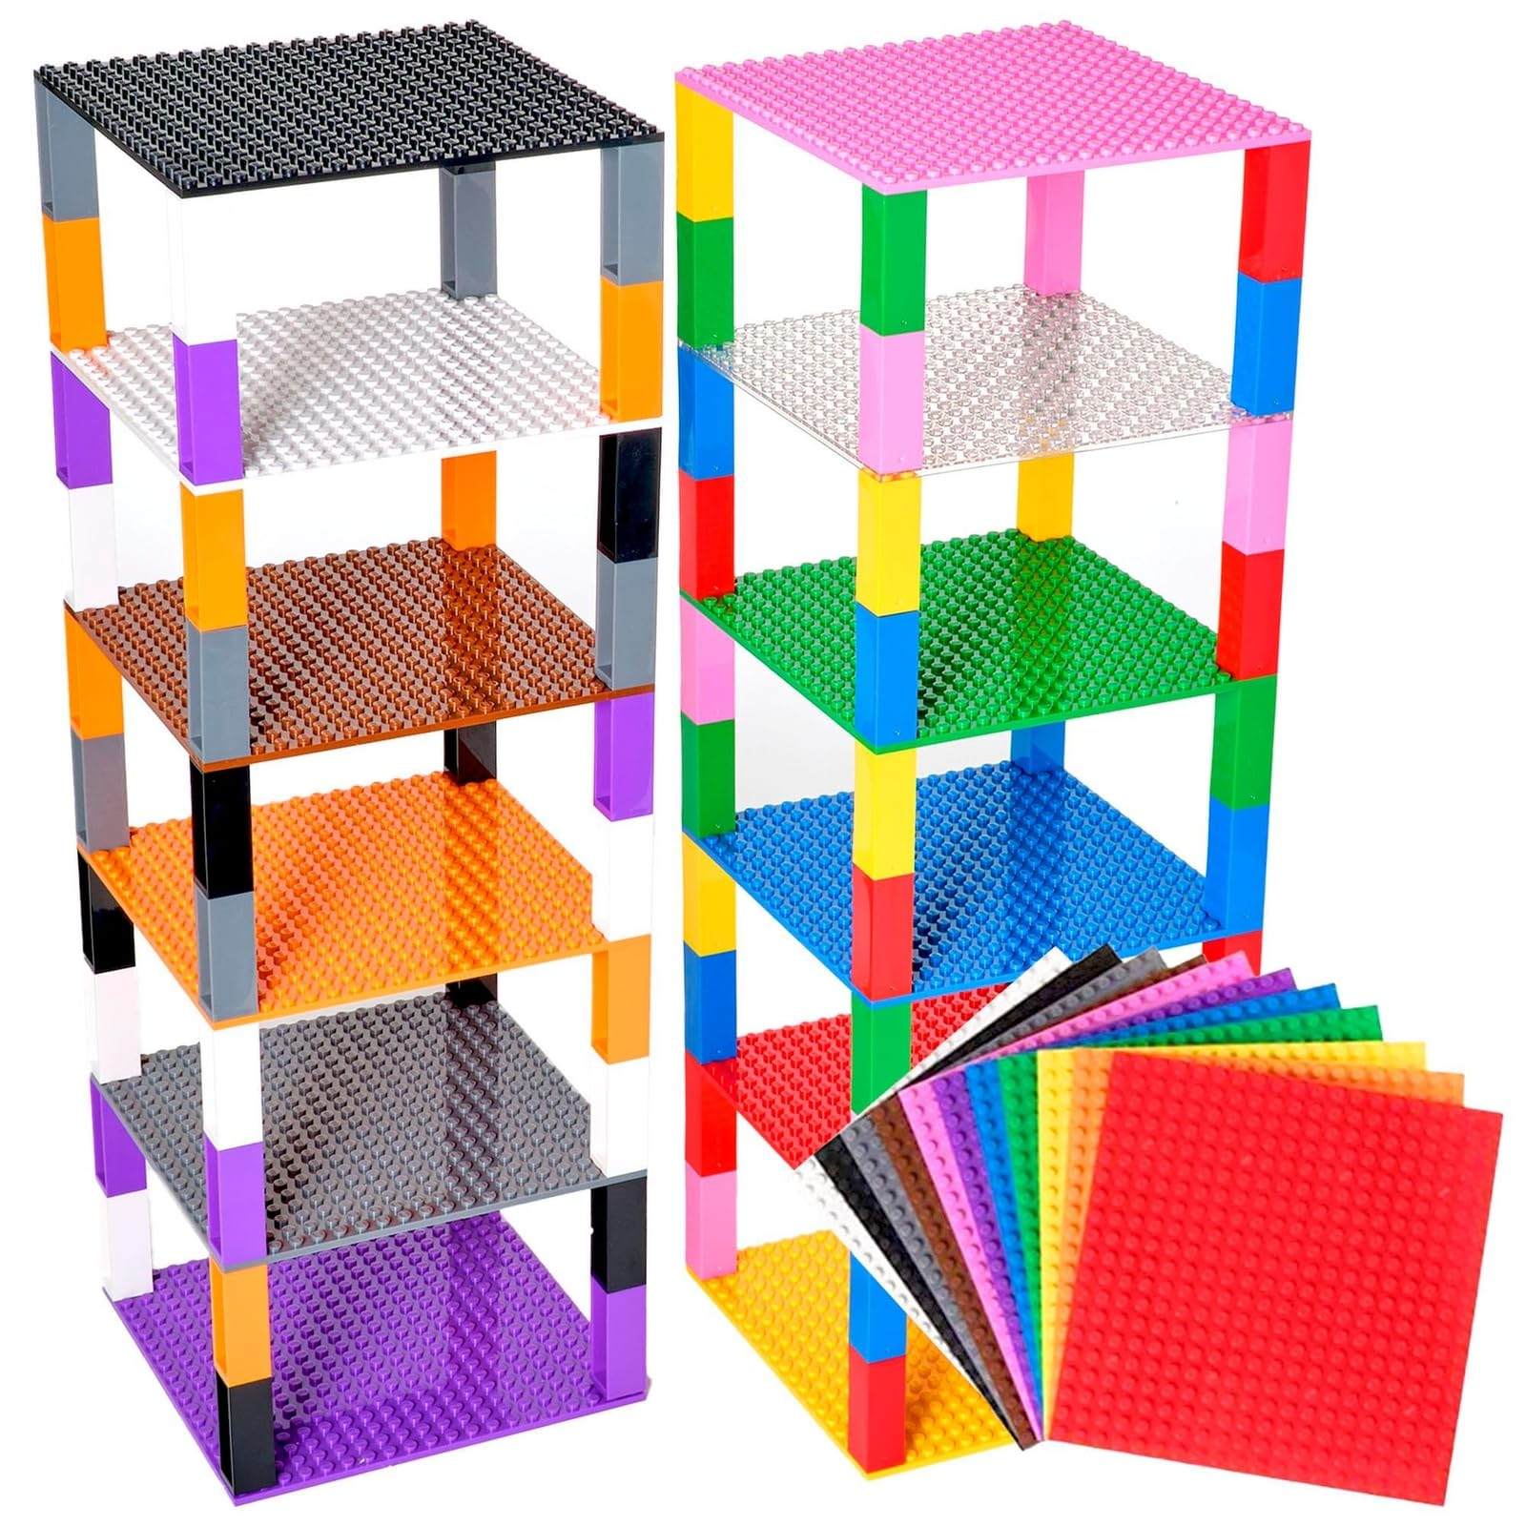
Tensor
Stacking tables on top of each other.
On the right, as we stacked the different base plate on top of each other, to know what's happening on each level, we need not just the row and column, but which map we're looking at! This is like a tensor. We need three pieces of information to pinpoint something: which 'layer' (map), which row, and which column.
Think of it like a LEGO building with multiple floors. To tell someone exactly where a specific brick is, you need the Floor Number, the Row on that floor, and the Column on that floor!

Slide 8
Tensors
Tensors are just super organized ways to store and understand information. They're like LEGO containers that can be designed to hold information in different ways – single facts, lists, tables, or even stacks of tables! They help scientists, engineers, and even game designers keep track of huge amounts of information that can change and move around.
Real World Connection: When you play a video game, the computer uses tensors to know where every object is, its color, its size, and how it's moving!

Slide 9
References
PyTorch. “Tensors.” PyTorch, 2024, https://pytorch.org/docs/stable/tensors.html.

